Slide 1
Computer Systems Organization
Chapter 2

Slide 2
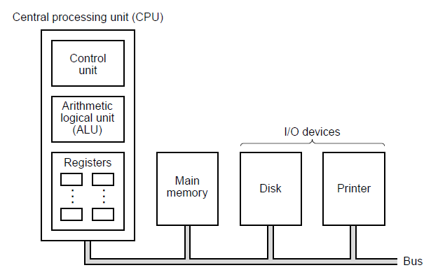
Processors
Figure 2-1. The organization of a simple computer with
one CPU and two I/O devices.

Slide 3
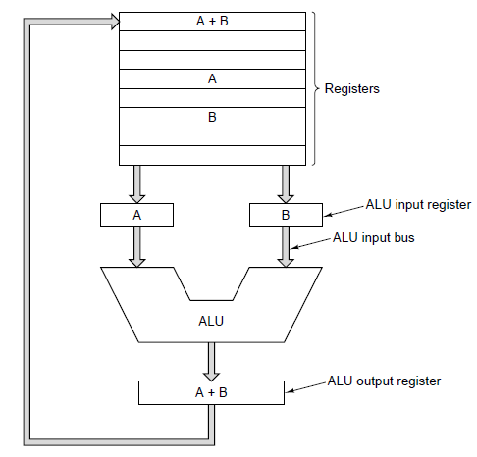
CPU Organization
Figure 2-2. The data path of a typical von Neumann machine.

Slide 4
Instruction Execution (1)
Fetch next instruction from memory
Change program counter to point to next instruction
Determine type of instruction just fetched
If instruction uses a word in memory, locate it
Fetch word, if needed, into a CPU register.
Execute instruction.
Go to step 1 to begin executing following instruction

Slide 5
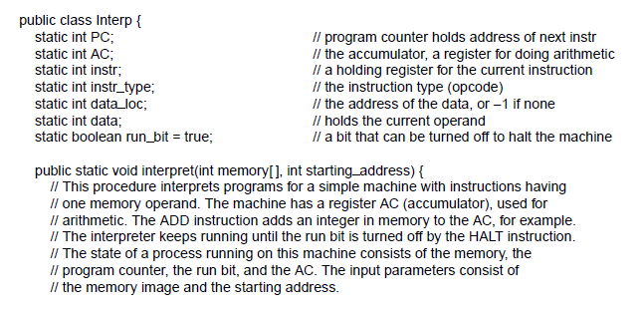
Instruction Execution (3)
. . .
Figure 2-3. An interpreter for a simple computer (written in Java).

Slide 6
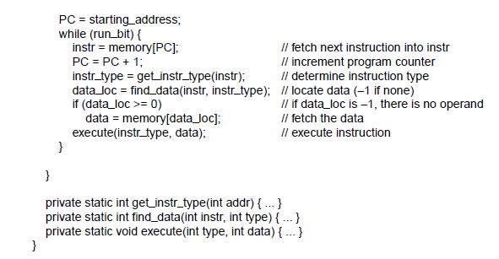
Instruction Execution (4)
. . .
Figure 2-3. An interpreter for a simple computer (written in Java).

Slide 7
Instruction Execution (5)
Benefits of machines with interpreted instructions
Ability to fix incorrectly implemented instructions in field,
even make up for design deficiencies in basic hardware
Opportunity to add new instructions at minimal cost,
even after delivery of machine
Structured design that permitted efficient development,
testing, documenting of complex instructions

Slide 8
Design Principles for Modern Computers
All instructions directly executed by hardware
Maximize rate at which instructions are issued
Instructions should be easy to decode
Only loads and stores should reference memory
Provide plenty of registers

Slide 9
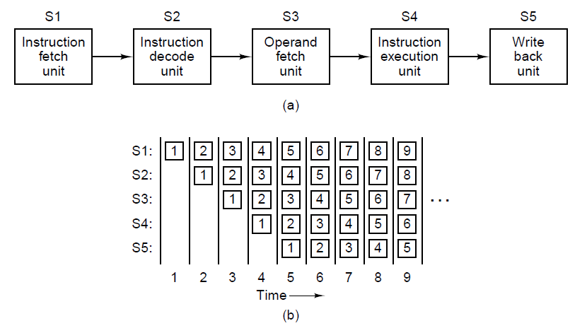
Pipelining
Figure 2-4. (a) A five-stage pipeline. (b) The state of each stage as a function of time. Nine clock cycles are illustrated

Slide 10
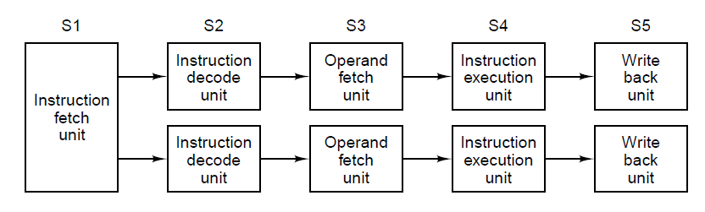
Superscalar Architectures (1)
Figure 2-5. Dual five-stage pipelines
with a common instruction fetch unit.

Slide 11
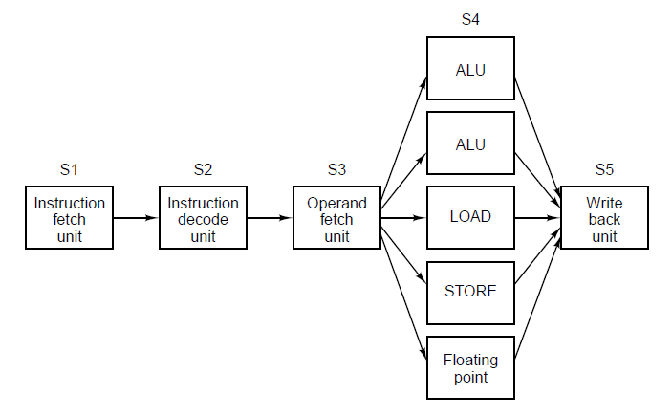
Superscalar Architectures (2)
Figure 2-6. A superscalar processor with five functional units.

Slide 12
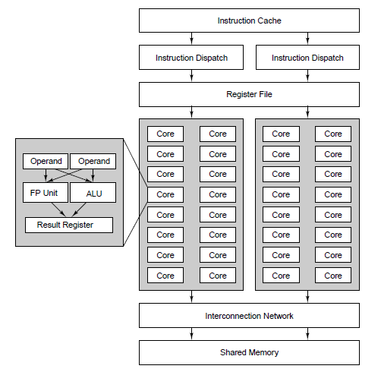
Data Parallel Computers
Figure 2-7. The SIMD core of the Fermi graphics processing unit.

Slide 13
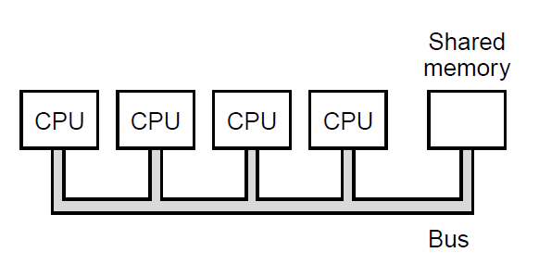
Multiprocessors (1)
Figure 2-8. (a) A single-bus multiprocessor.

Slide 14
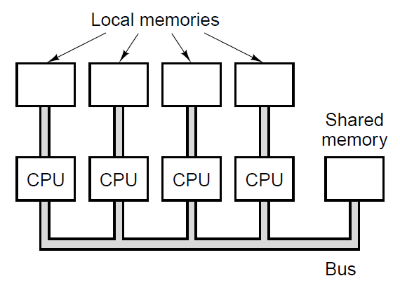
Multiprocessors (1)
Figure 2-8(b) A multicomputer with local memories.

Slide 15
Primary Memory (1)
The part of computer where programs and data are stored
Bit: binary digit
Memory address: location in memory of a cell containing data

Slide 16
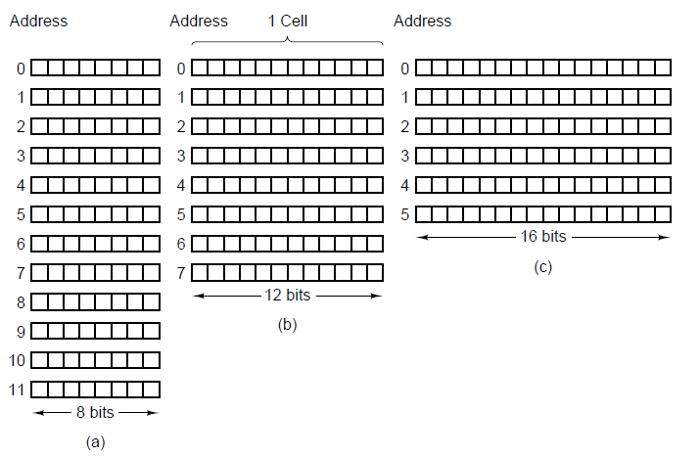
Primary Memory (2)
Figure 2-9. Three ways of organizing a 96-bit memory

Slide 17
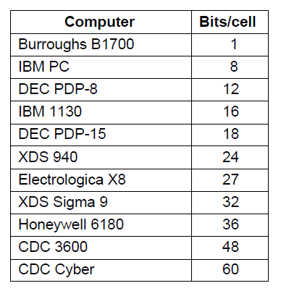
Primary Memory (3)
Figure 2-10. Number of bits per cell for some historically interesting commercial computers.

Slide 18
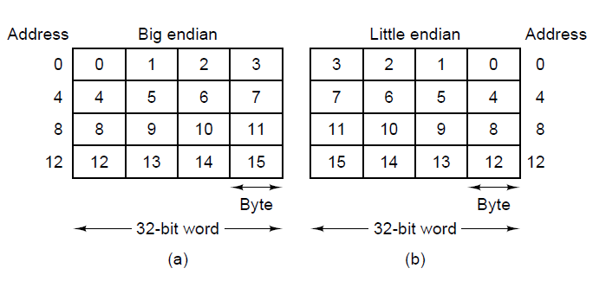
Byte Ordering (1)
Figure 2-11. (a) Big endian memory. (b) Little endian memory.

Slide 19
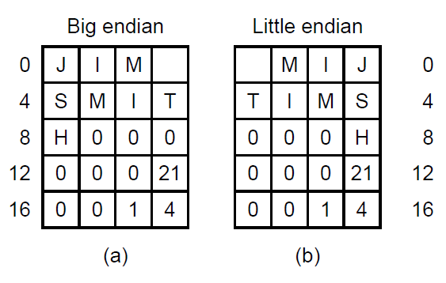
Byte Ordering (2)
Figure 2-12. (a) A personnel record for a big endian machine.
(b) The same record for a little endian machine.

Slide 20
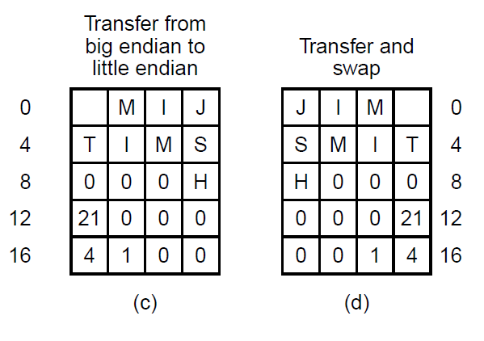
Byte Ordering (3)
Figure 2-12. (c) The result of transferring the record from a
big endian to a little endian. (d) The result of byte swapping (c).

Slide 21
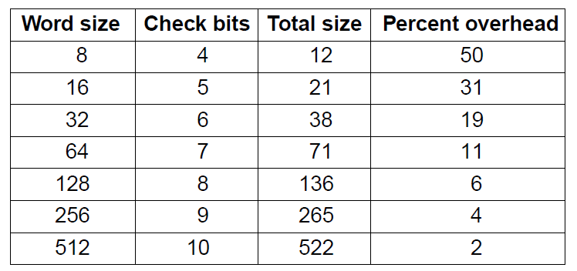
Error-Correcting Codes (1)
Figure 2-13. Number of check bits for a code
that can correct a single error.

Slide 22
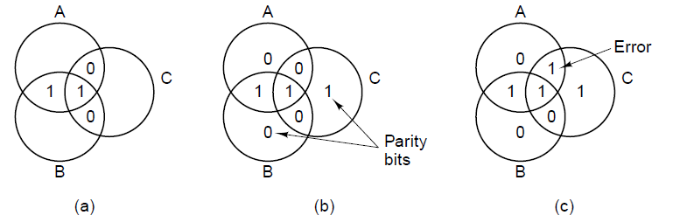
Error-Correcting Codes (2)
Figure 2-14. (a) Encoding of 1100.
(b) Even parity added.
(c) Error in AC.

Slide 23
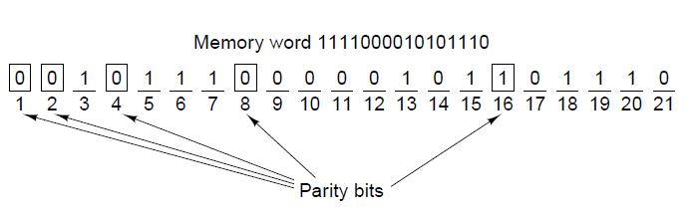
Error-Correcting Codes (3)
Figure 2-15. Construction of the Hamming code
for the memory word 1111000010101110 by
adding 5 check bits to the 16 data bits.

Slide 24
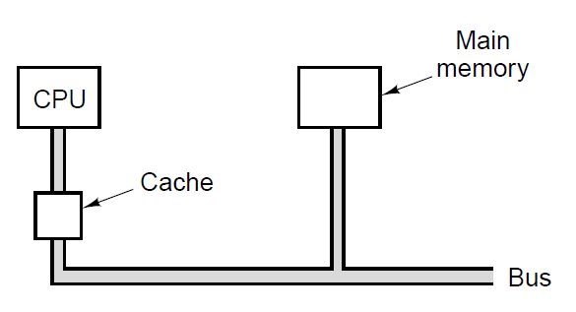
Cache Memory
Figure 2-16. The cache is logically between the CPU
and main memory. Physically, there are several
possible places it could be located.

Slide 25
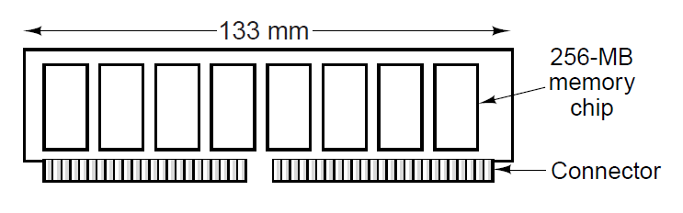
Memory Packaging and Types
Figure 2-17. Top view of a DIMM holding 4 GB with eight
chips of 256 MB on each side. The other side looks the same.

Slide 26
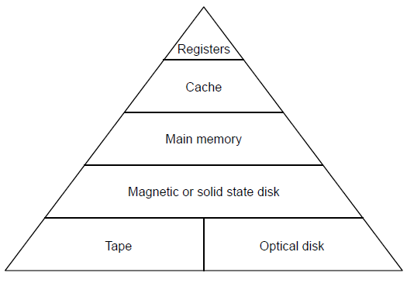
Secondary Memory
Memory Hierarchies
Figure 2-18. A five-level memory hierarchy.

Slide 27
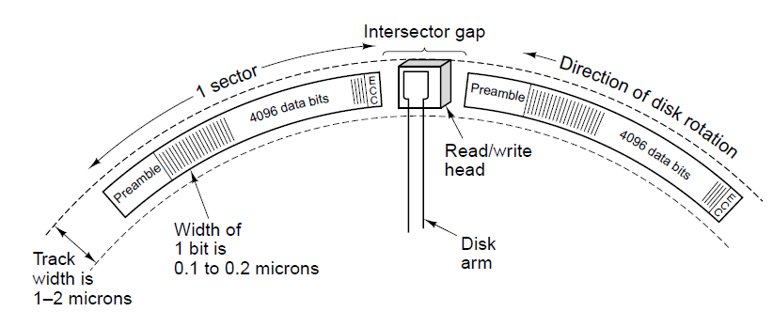
Magnetic Disks (1)
Figure 2-19. A portion of a disk track. Two sectors are illustrated.

Slide 28
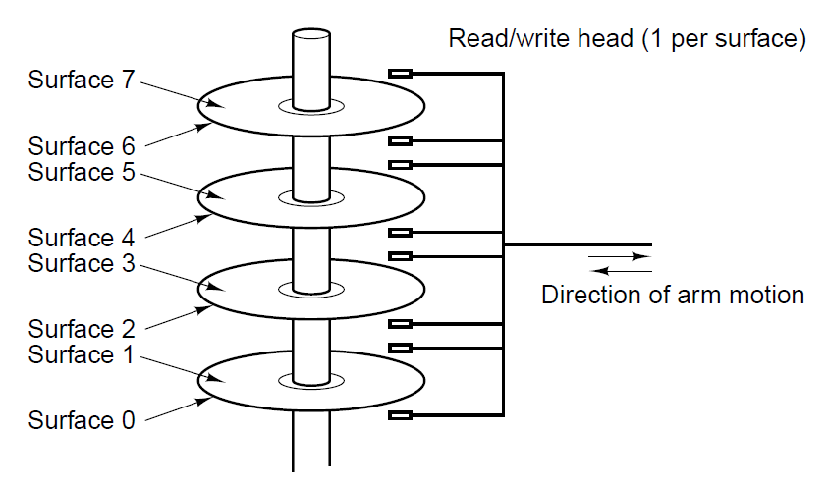
Magnetic Disks (2)
Figure 2-20. A disk with four platters.

Slide 29
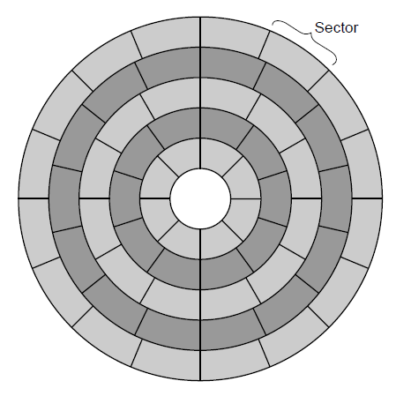
Magnetic Disks (3)
Figure 2-21. A disk with five zones. Each zone has many tracks.

Slide 30
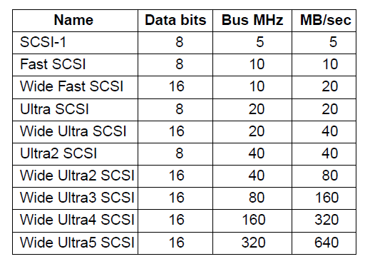
SCSI Disks
Figure 2-22. Some of the possible SCSI parameters

Slide 31
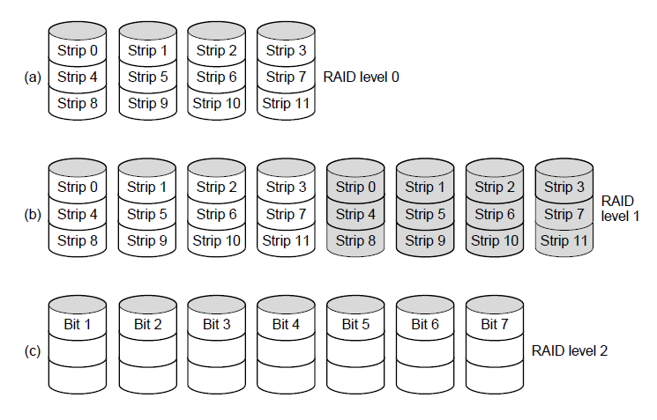
RAID (1)
Figure 2-23. RAID levels 0 through 5. Backup and
parity drives are shown shaded.

Slide 32
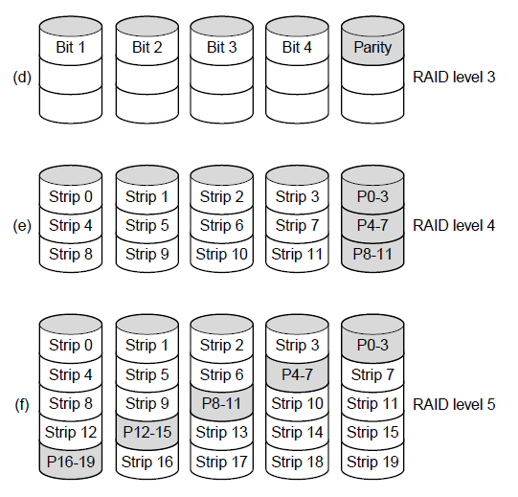
RAID (2)
Figure 2-23. RAID levels 0 through 5. Backup and
parity drives are shown shaded.

Slide 33
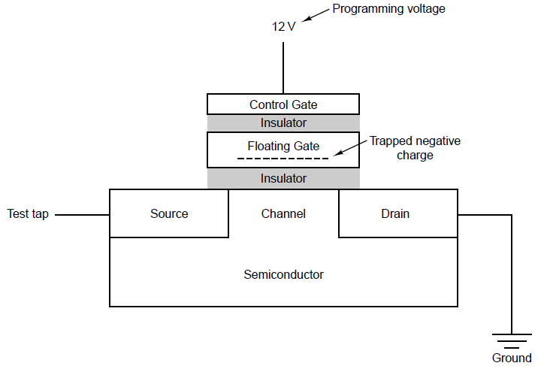
Solid-State Disks
Figure 2-24. A flash memory cell.

Slide 34
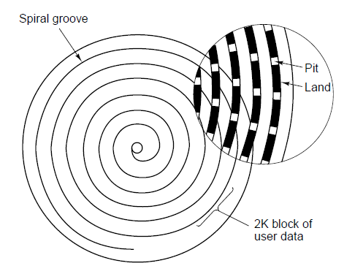
CD-ROMs (1)
Figure 2-25. Recording structure of a Compact Disc or CD-ROM.

Slide 35
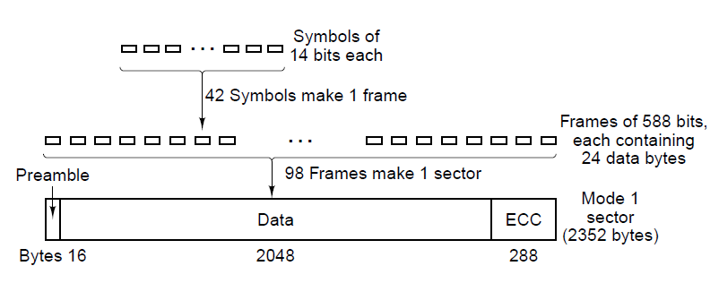
CD-ROMs (2)
Figure 2-26. Logical data layout on a CD-ROM.

Slide 36
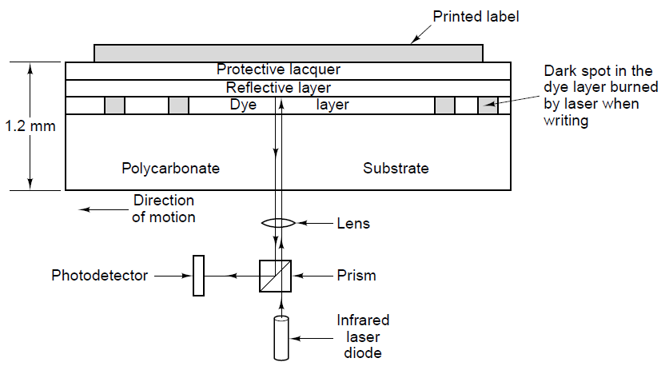
CD-Recordables
Figure 2-27. Cross section of a CD-R disk and laser (not to scale). A CD-ROM has a similar structure, except without the dye layer and with a pitted aluminum layer instead of a reflective layer.

Slide 37
DVD (1)
Was Digital Video Disk
Now Digital Versatile Disk
New features
  Smaller pits
  A tighter spiral
  A red laser

Slide 38
DVD (2)
Formats:
Single-sided, single-layer (4.7 GB)
Single-sided, dual-layer (8.5 GB)
Double-sided, single-layer (9.4 GB)
Double-sided, dual-layer (17 GB)

Slide 39
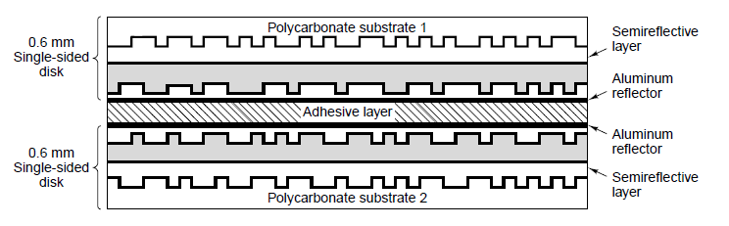
DVD (3)
Figure 2-28 A double sided, dual layer DVD disk.

Slide 40
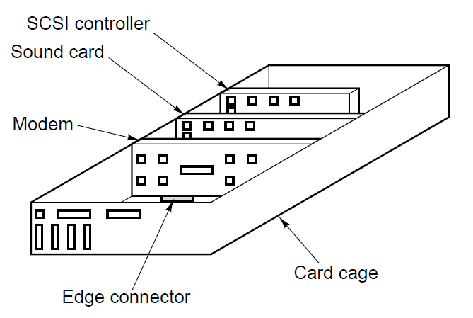
Input/Output Buses (1)
Figure 2-29. Physical structure of a personal computer.

Slide 41
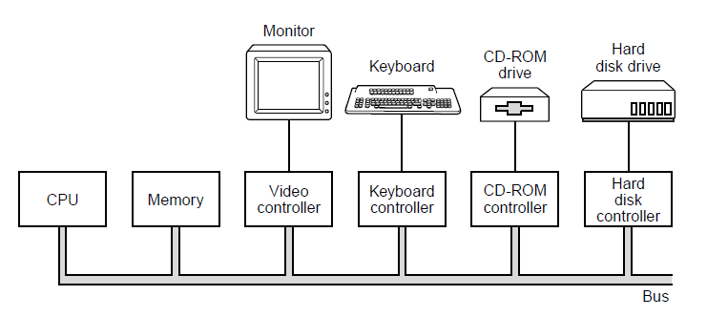
Buses (2)
Figure 2-30. Logical structure of a simple personal computer.

Slide 42
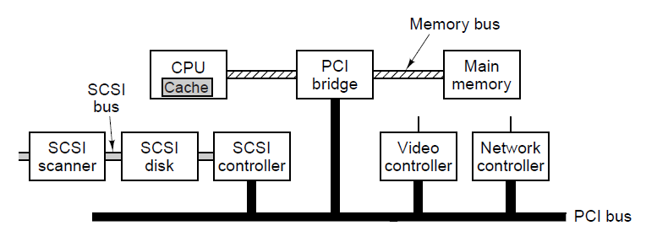
PCI and PCIe Buses (1)
Figure 2-31. A typical PC built around the PCI bus. The SCSI controller is a PCI device.

Slide 43
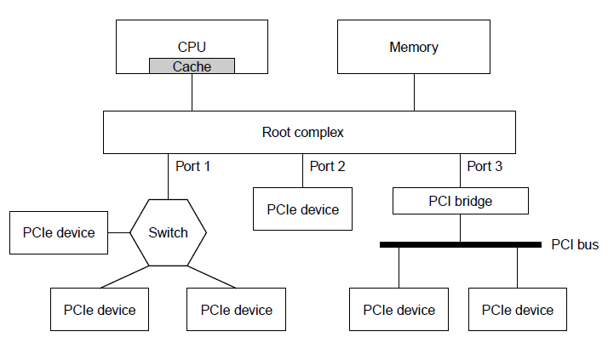
PCI and PCIe Buses (2)
Figure 2-32. Sample architecture of a PCIe system
with three PCIe ports.

Slide 44
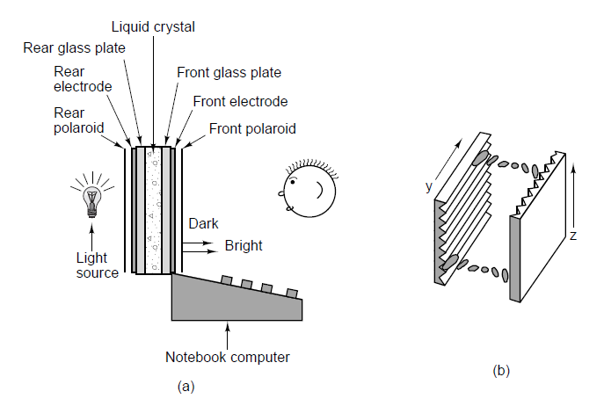
Terminals
Figure 2-33. (a) The construction of an LCD screen.
(b) The grooves on the rear and front plates are
perpendicular to one another.

Slide 45
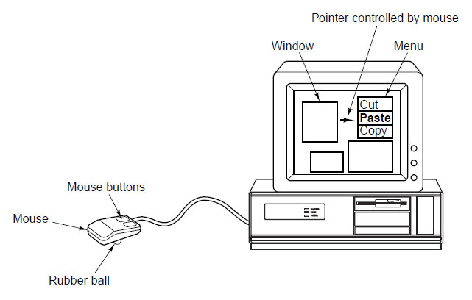
Mice
Figure 2-34. A mouse being used to point to menu items.

Slide 46
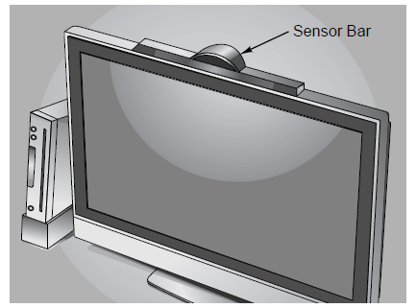
Game Controllers (1)
Figure 2-35. The Wiimote video game controller motion sensors.

Slide 47
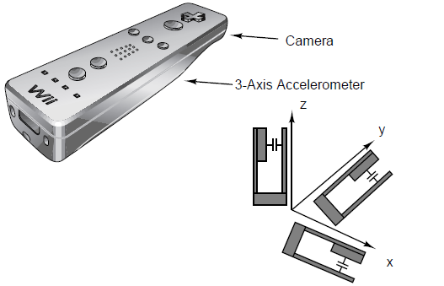
Game Controllers (2)
Figure 2-35. The Wiimote video game controller motion sensors.

Slide 48
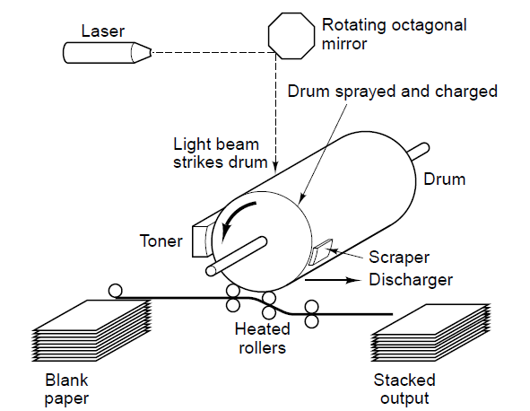
Laser Printers (1)
Figure 2-36. Operation of a laser printer.

Slide 49
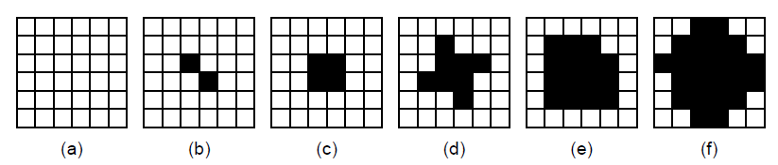
Laser Printers (2)
Figure 2-37. Halftone dots for various grayscale ranges. (a) 0–6. (b) 14–20. (c) 28–34. (d) 56–62. (e) 105–111. (f) 161–167.

Slide 50
Color Printing
Color monitors use transmitted light;
  Color printers use reflected light.
Monitors have 256 intensities per color;
  Color printers must halftone.
Monitors have a dark background;
  Paper has a light background.
The RGB gamut of a monitor and the CMYK gamut of a printer are different.

Slide 51
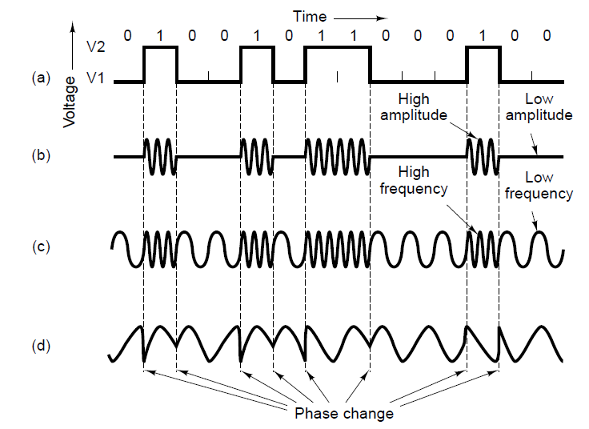
Modems
Figure 2-38. Transmission of the binary number 01001011000100 over a telephone line bit by bit. (a) Two-level signal. (b) Amplitude modulation. (c) Frequency modulation. (d) Phase modulation.

Slide 52
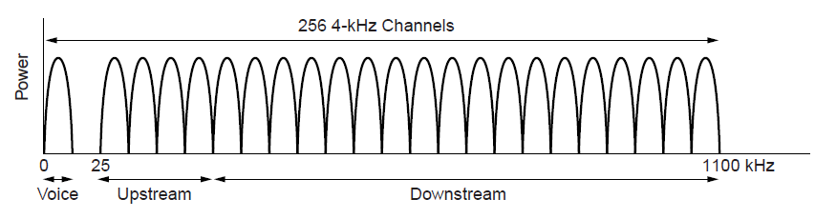
Digital Subscriber Lines (1)
Figure 2-39. Operation of ADSL.

Slide 53
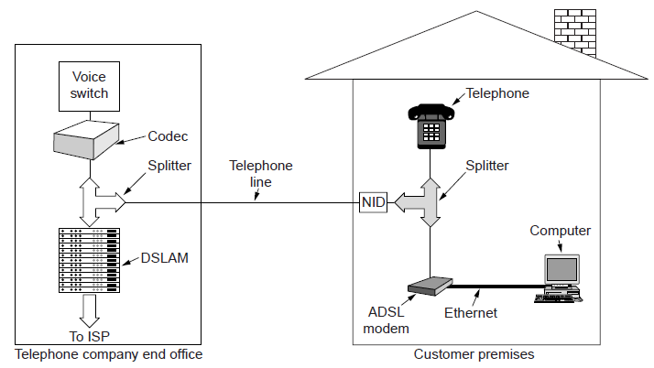
Digital Subscriber Lines (2)
Figure 2-40. A typical ADSL equipment configuration.

Slide 54
Internet over Cable (1)
Problems to overcome:
How to add Internet access without interfering with TV programs.
How to have two-way traffic when amplifiers are inherently one way.

Slide 55
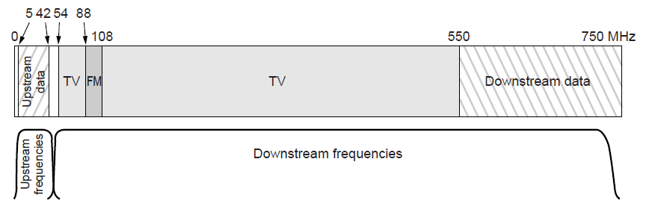
Internet over Cable (2)
Figure 2-41. Frequency allocation in a typical cable
TV system used for Internet access.

Slide 56
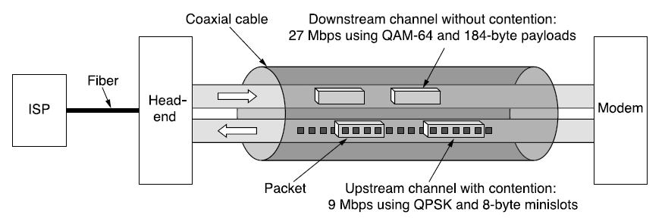
Internet over Cable (3)
Figure 2-42. Typical details of the upstream and downstream channels in North America. QAM-64 allows 6 bits/Hz but works only at high frequencies. QPSK works at low frequencies but allows only 2 bits/Hz.

Slide 57
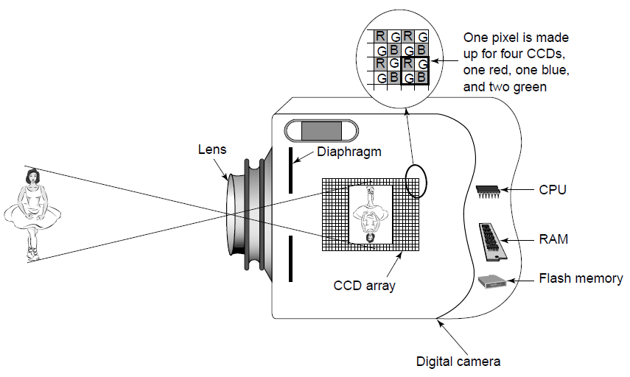
Digital Cameras
Figure 2-43. A digital camera.

Slide 58
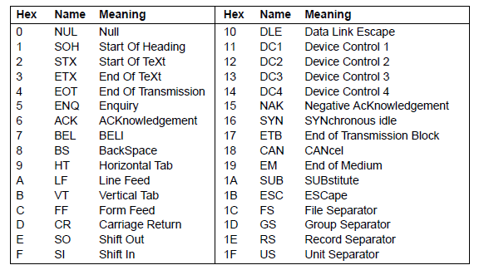
Character Codes (1)
Figure 2-44. The ASCII character set.

Slide 59
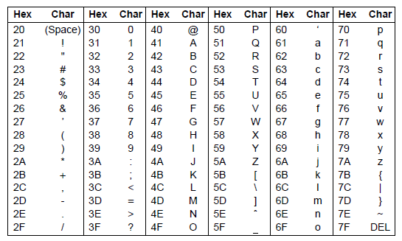
Character Codes (2)
Figure 2-44. The ASCII character set.

Slide 60

Character Codes (3)
Figure 2-45. The UTF-8 encoding scheme.

Slide 61
End
Chapter 2

